Slide 1


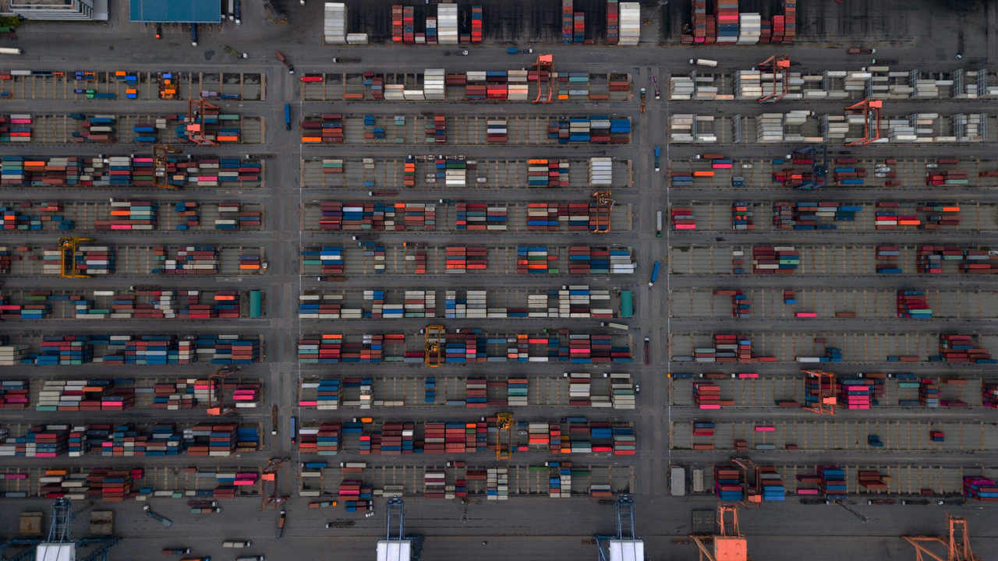

Containerisierung at Swiss Post IT
Technische Angaben
Bildgrösse:
Vollflächig
B 33,87 cm x H 19,05 cm
entsprechen
B 2000 Pixel x H 1125 Pixel
Auflösung 150 dpi
Bilder einfügen:
«Post-Menü > Bild»
Weitere Bilder unter www.brandingnet.ch

Slide 2

What are we doing today? Table of Content
Introducing round
Middleware Engineering
What is a Container?
Docker Container Introduction
Docker installation
Docker Examples
Hello World
Apache Webserver
Gitea
WikiJS
Kubernetes Demo

Slide 3
Introducing Round Who are we? Who are you?

Slide 4
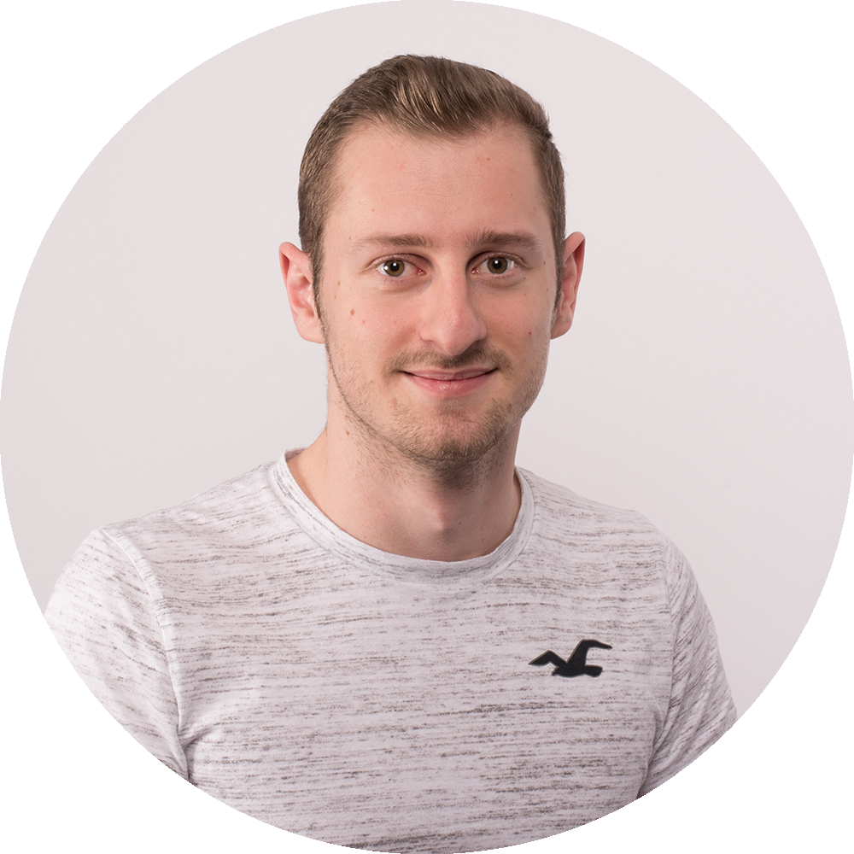
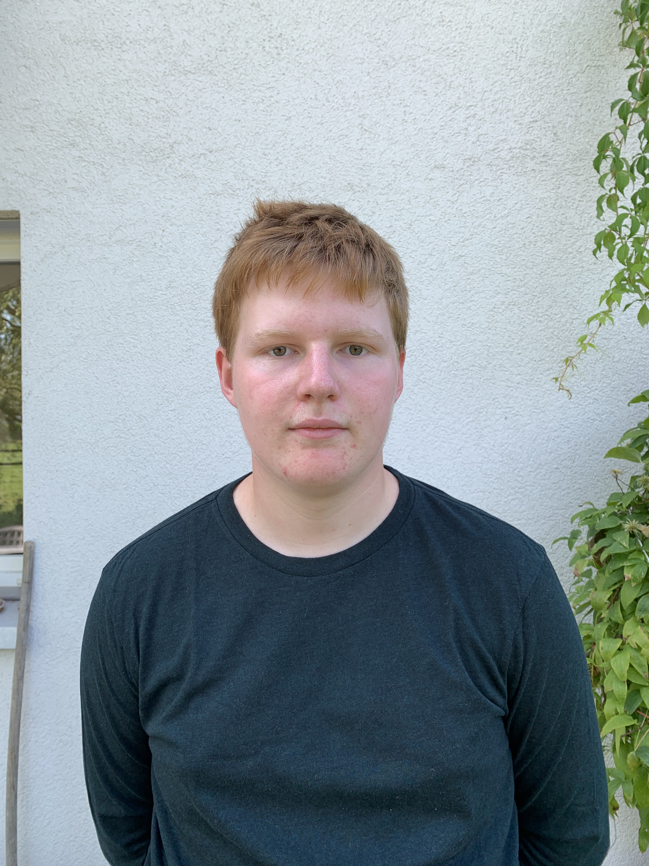
Who we are
Patrick Bühlmann Middleware Engineering
Nathanael Liechti Middleware Engineer Lernender
Work area:
Kubernetes / OpenShift Engineering
Docker, Cloud, Automation
DevOps CI / CD
Work area:
Kubernetes Engineering
Go Coding (Microservices and more)
+41 76 342 82 59
-
patrick.buehlmann.1@post.ch
Nathanael.lichti@post.ch

Slide 5
Who are you? A short introduction
What is you name?
Do you have experience with Docker, Kubernetes or in generally Container?
How motivated are you from a scale 0 (bad) to 10 (verry god)?

Slide 6
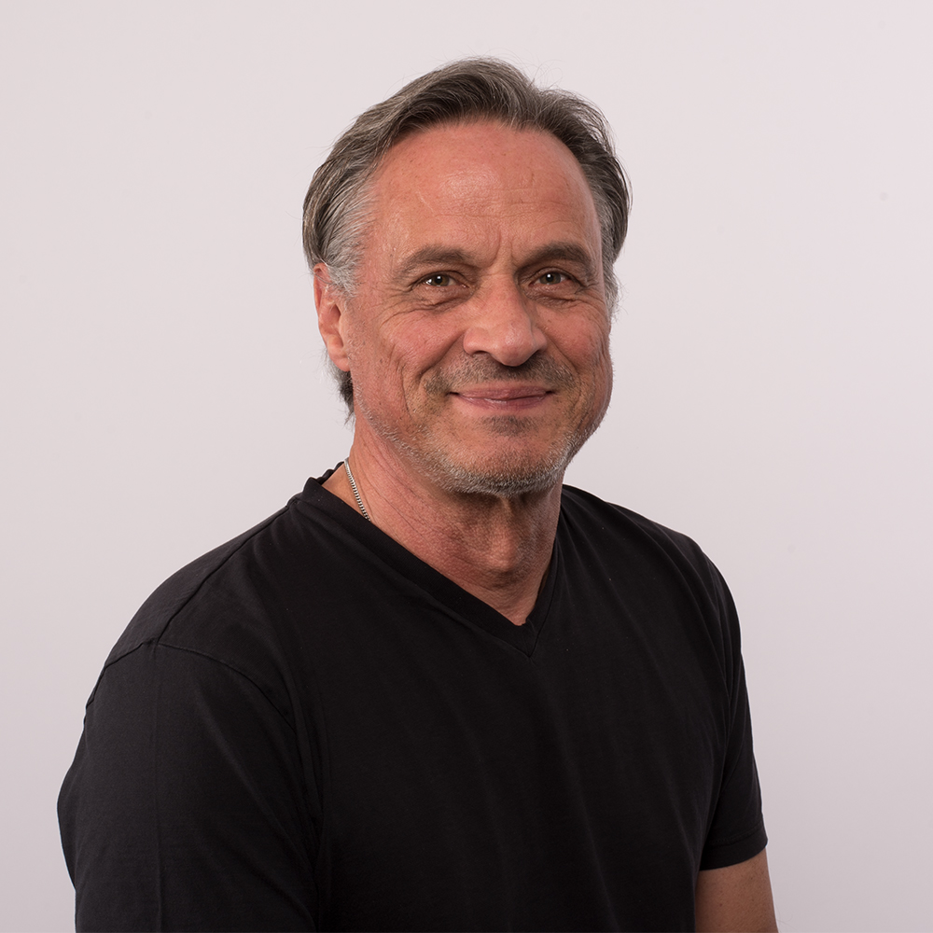
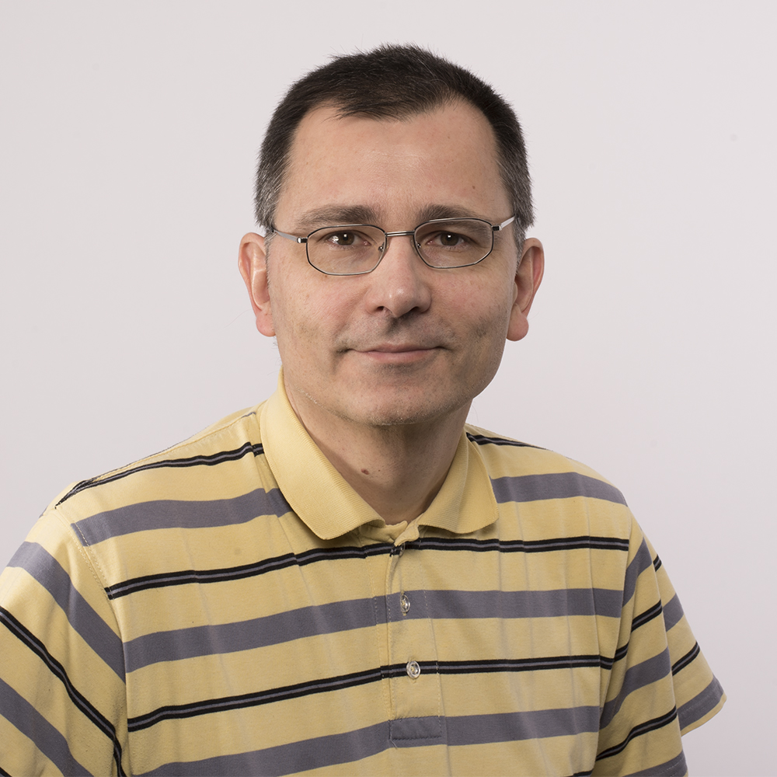
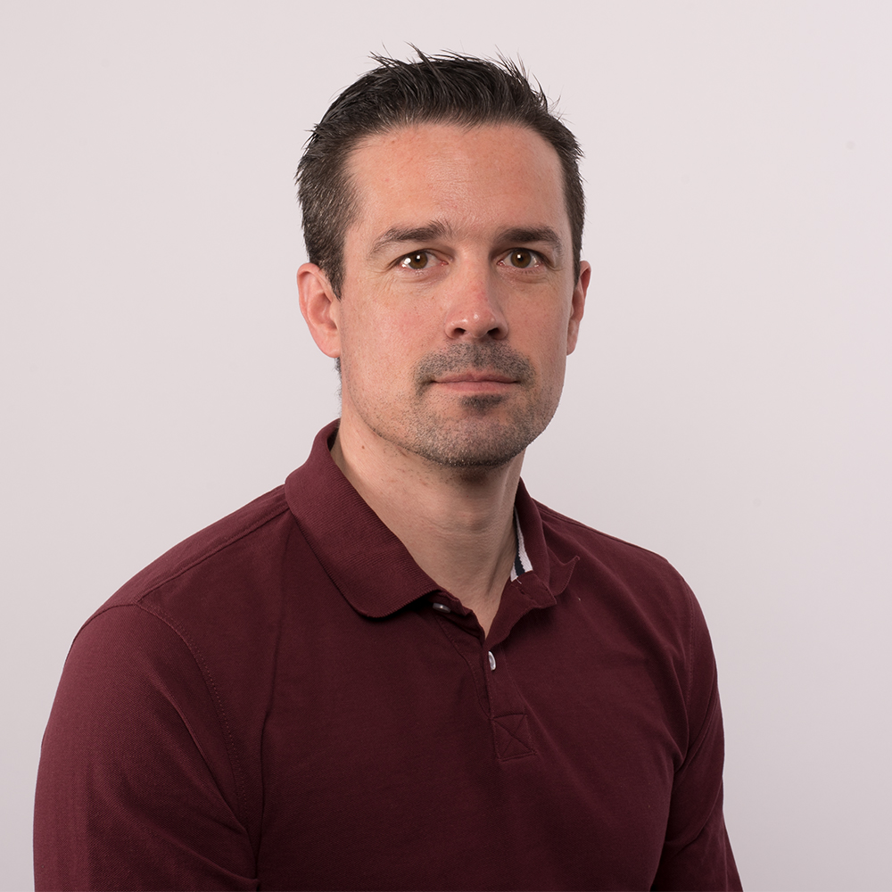
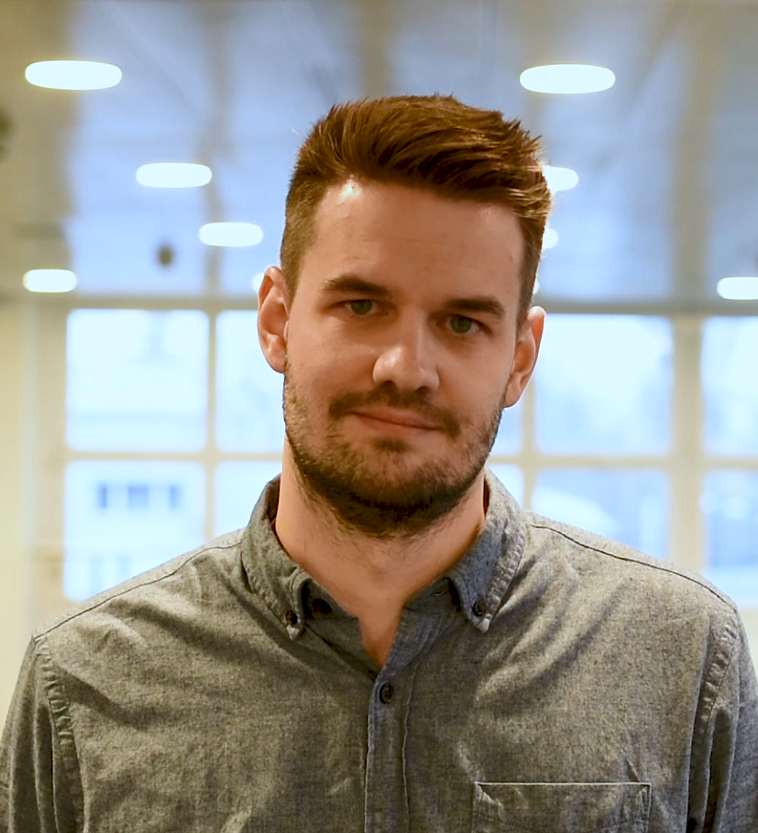

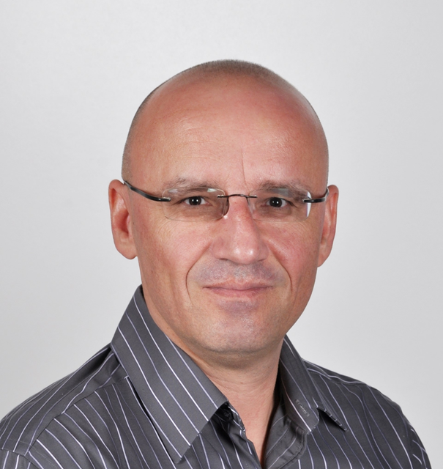
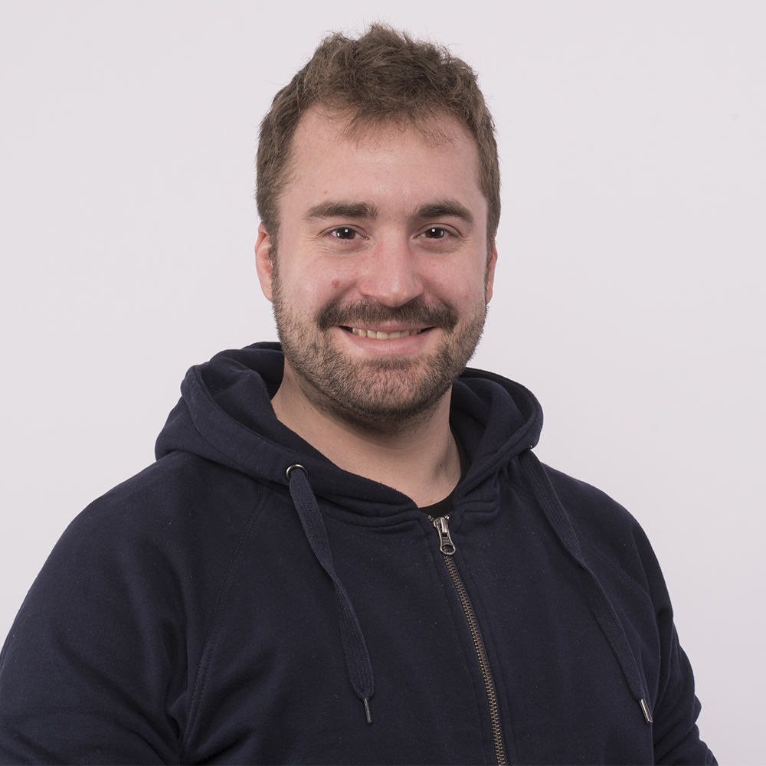
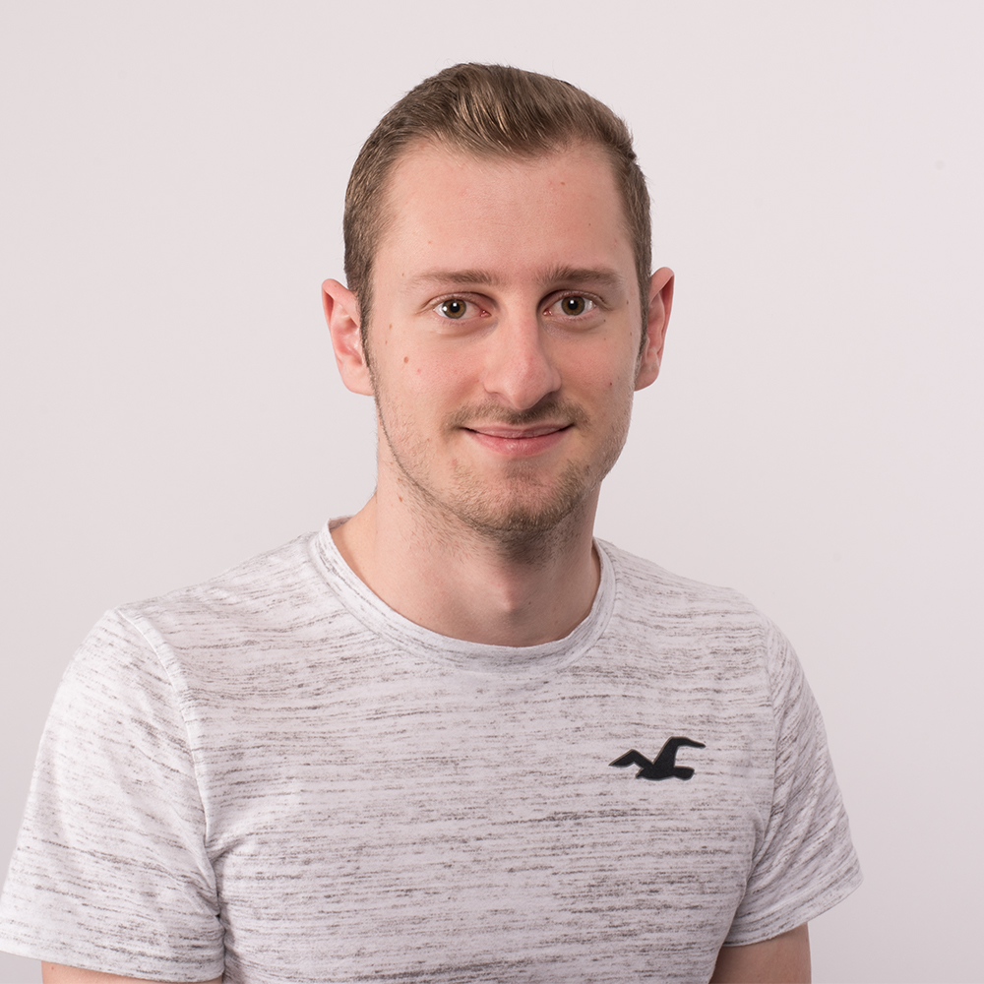
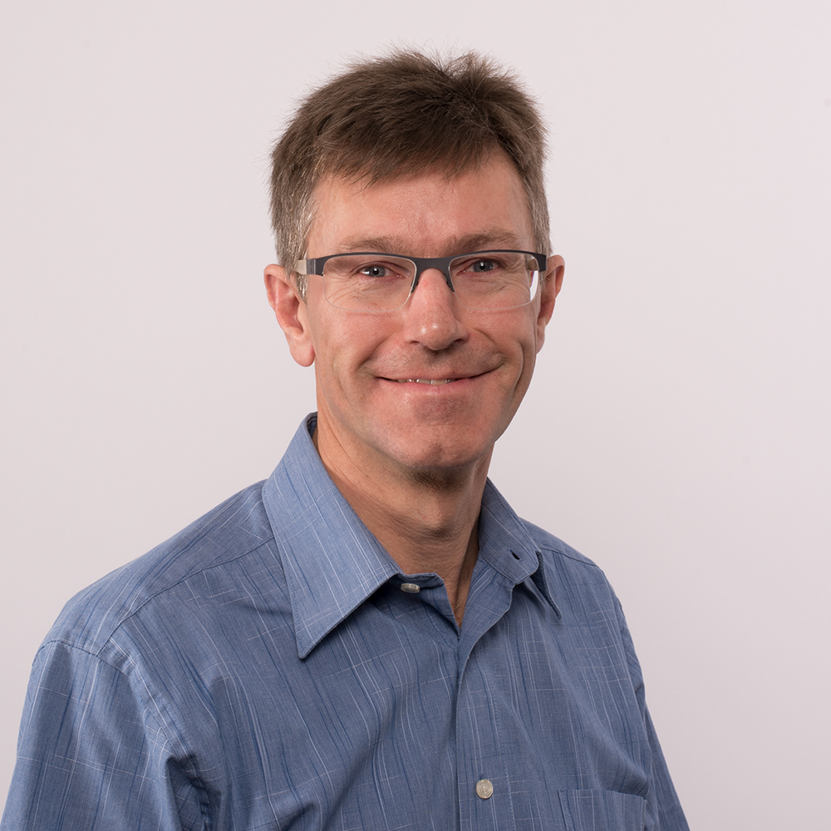
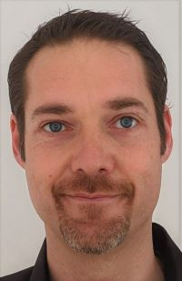
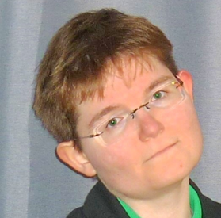
Middleware Engineering Our team

Slide 7
Middleware Engineering What is Engineering?
Systematic design of computer science systems
Create and implement concepts / products
ICT-System-Ingenieur:
Planning, procurement, commissioning, testing and acceptance of platforms (hardware, software, networks, including cloud environments) for the operation of ICT systems; definition of operational requirements
https://www.berufe-der-ict.ch/berufe/entwicklung/ict-system-ingenieur

Slide 8

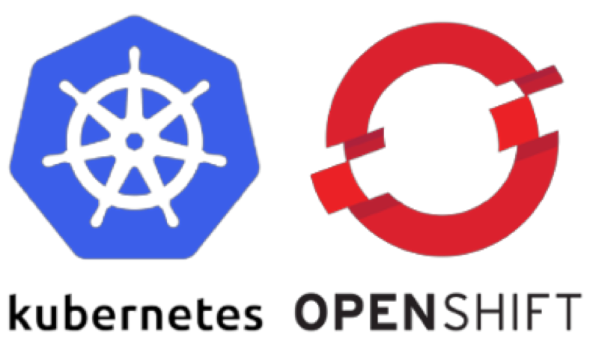
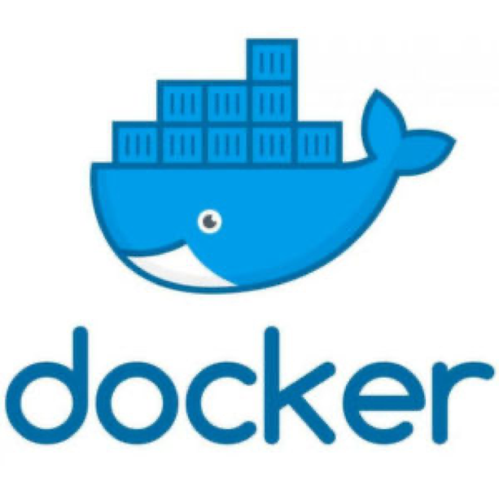







Middleware Engineering Engineering Tools

Slide 9
Middleware Engineering What does an Engineer in his daily business?
Scripts, Automate
Terminal, Shell
Work with Linux all day long
Searching and developing new solutions
Try somthing new
Questioning the existing
Interest in system / network

Slide 10
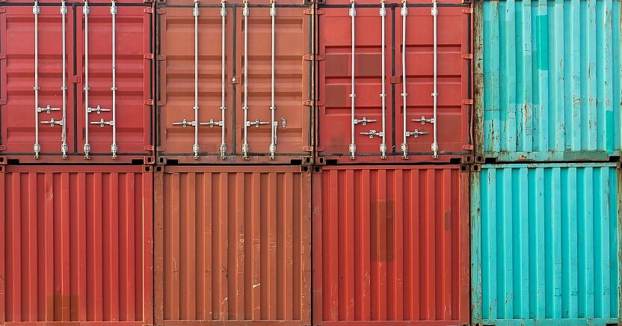
Container What the hell is a container?

Slide 11
Container What is a Container?
“Containers are a form of operating system virtualization. A single container might be used to run anything from a small microservice or software process to a larger application. Inside a container are all the necessary executables, binary code, libraries, and configuration files. Compared to server or machine virtualization approaches, however, containers do not contain operating system images. This makes them more lightweight and portable, with significantly less overhead. In larger application deployments, multiple containers may be deployed as one or more container clusters.
Such clusters might be managed by a container orchestrator such as Kubernetes.”

Slide 12
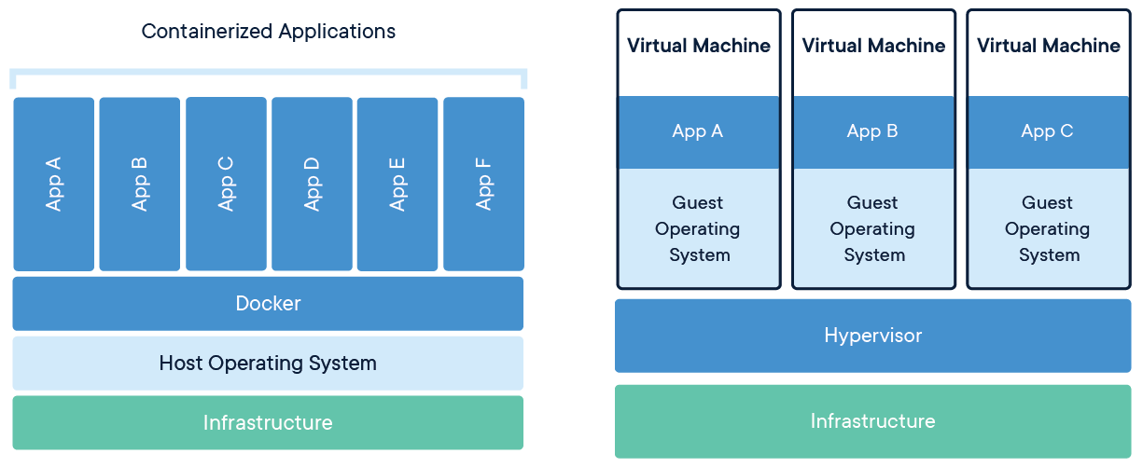
Container Comparison between Containerized and Virtual Machines
Share kernel and isolate the application process
Extremly portable
Very lightweight
One process in a container
No data in a container (use volumes)

Slide 13
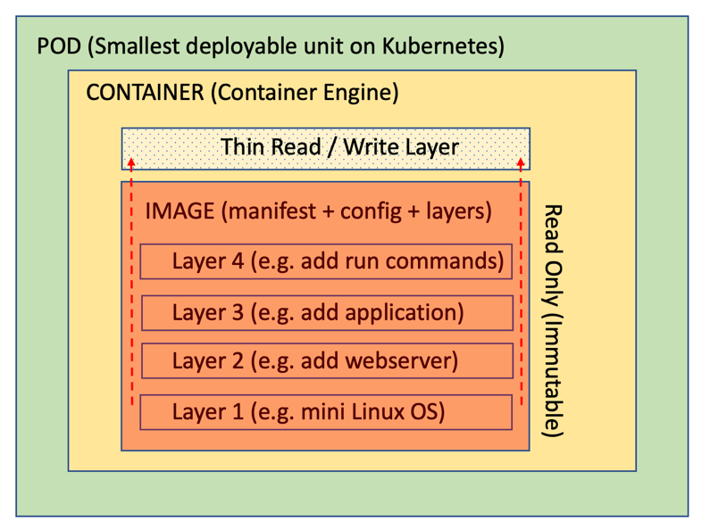
Container Inside of a Container

Slide 14
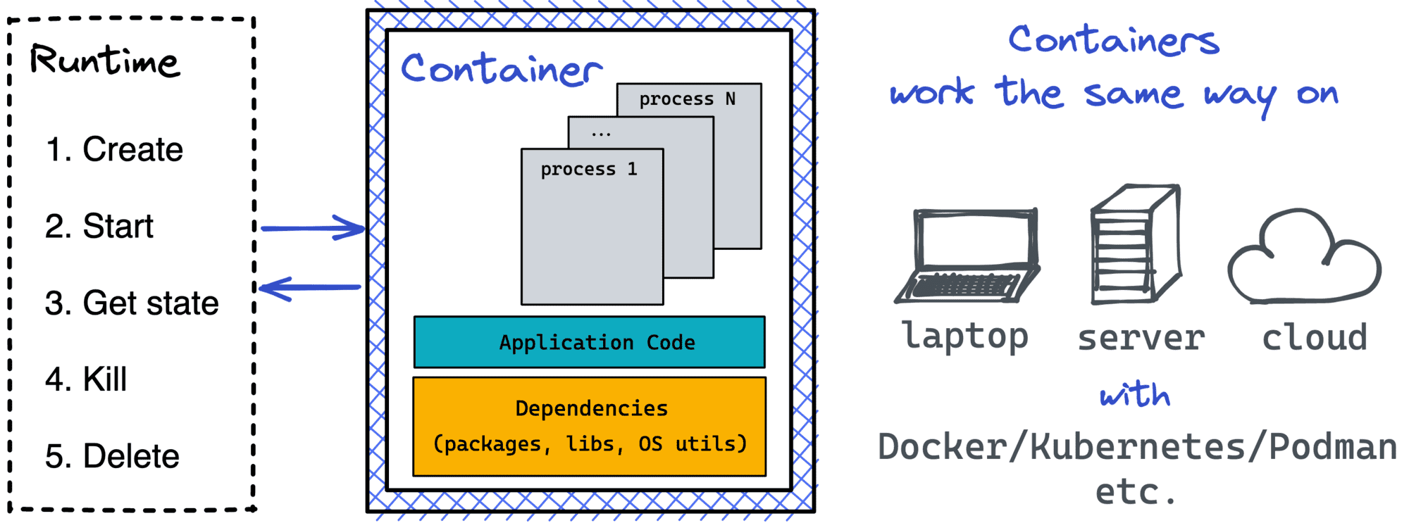
Container Interact with a Container

Slide 15

Container Benefits of containers
Less overhead
Increased portability
More consistent operation
Greater efficiency
Better application development
Much faster deployment
Save costs
Notes:
Less overhead Containers require less system resources than traditional or hardware virtual machine environments because they don’t include operating system images.
Increased portability Applications running in containers can be deployed easily to multiple different operating systems and hardware platforms.
More consistent operation DevOps teams know applications in containers will run the same, regardless of where they are deployed.
Greater efficiency Containers allow applications to be more rapidly deployed, patched, or scaled.
Better application development Containers support agile and DevOps efforts to accelerate development, test, and production cycles.

Slide 16
Docker Create, deploy and run Container

Slide 17
Docker What is Docker?
Docker is a software platform designed to make it easier to create, deploy, and run applications by using containers. It allows developers to package up an application with all the parts it needs in a container, and then ship it out as one package.
Build, share and run any application, anywhere

Slide 18
Docker Container Docker Mechanism
Repository
Host
Image
Container
Registry
Docker Client
Daemon

Slide 19
Docker Container Workflow
Image
Container
Build
Run
Pull
Stop
Delete
Delete

Slide 20
Docker Container Docker Engine Commands
Container
Image
build
pull
tag
Rmi
logs
inspect
ps
Stop
kill
rm
bhjhfdjhfjdshshfdjfhsfkjdshfkjhsjhfdkjhf
run
start

Slide 21

Docker Container Installation of the technology Docker
https://www.digitalocean.com/community/tutorials/how-to-install-and-use-docker-on-debian-10

Slide 22
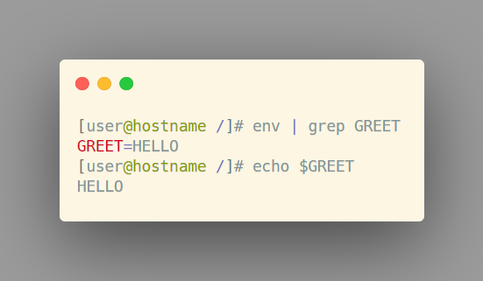
Docker Container Docker Runtime environment variables
Environment Variables docker run –it \ -e GREET=HELLO \ --rm centos

Slide 23
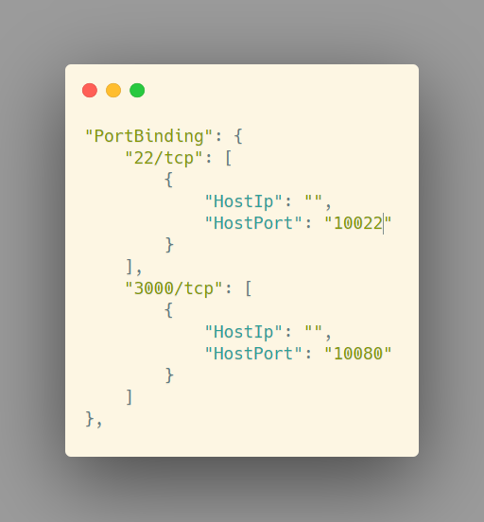
Docker Container Docker Runtime networking
Port translation docker run … -p 10022:22 …

Slide 24
Docker Container Docker Runtime volumes
Mount a directory from the host into the container docker run … -v /data/db:/var/lib/db …

Slide 25
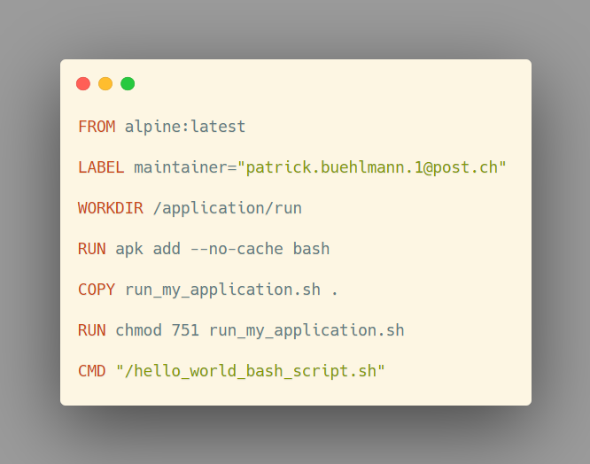

Docker Container The dockerfile is the truth
Dockerfile
Image
Container
Instruction-bases image build
FROM, ADD, RUN, COPY, CMD, USER
Cached layers
Dockerfile Cheat Sheet

Slide 26
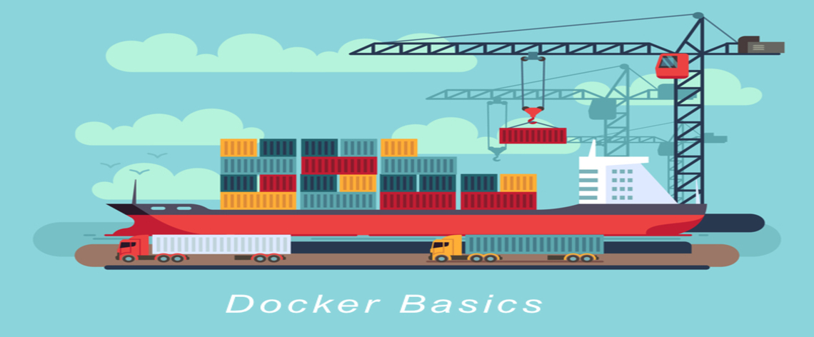
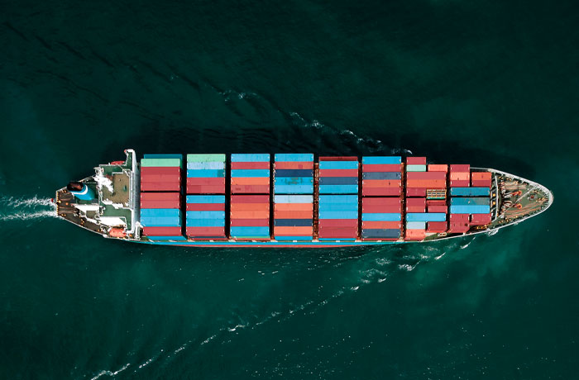
Fliesstext in einer Textspalte Schriftgrösse und Spaltenaufteilung
Fliesstext
Bei einem Layout mit einer Textspalte (ganzseitig) wird die für Fliesstext definierte Schriftgrösse verwendet. Die Schriftgrösse ist im Folienmaster festgelegt.
Technische Angaben Fliesstext
Frutiger Light, 20 Punkt; Zeilenabstand 1 Zeile; Nach einem Absatz 10 Punkt; Farbe Schwarz; Auszeichnungen im Text in Frutiger Bold

Slide 27
DOCKER EXERCISE «Hello World»

Slide 28
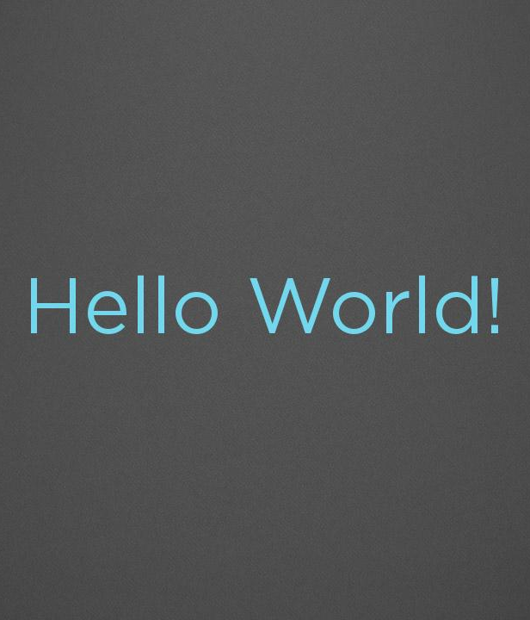

Docker Exercise Explanation of the exercise
docker run hello-world
docker ps –a
docker images

Slide 29
DOCKER EXERCISE «Hello World»

Slide 30
Docker Exercise Explanation of the exercise
Choose the right and a small base image (alpine, centos)
Create a bash script
Build and run the container
Is there a faster way?

Slide 31
DOCKER EXERCISE «Webserver»

Slide 32
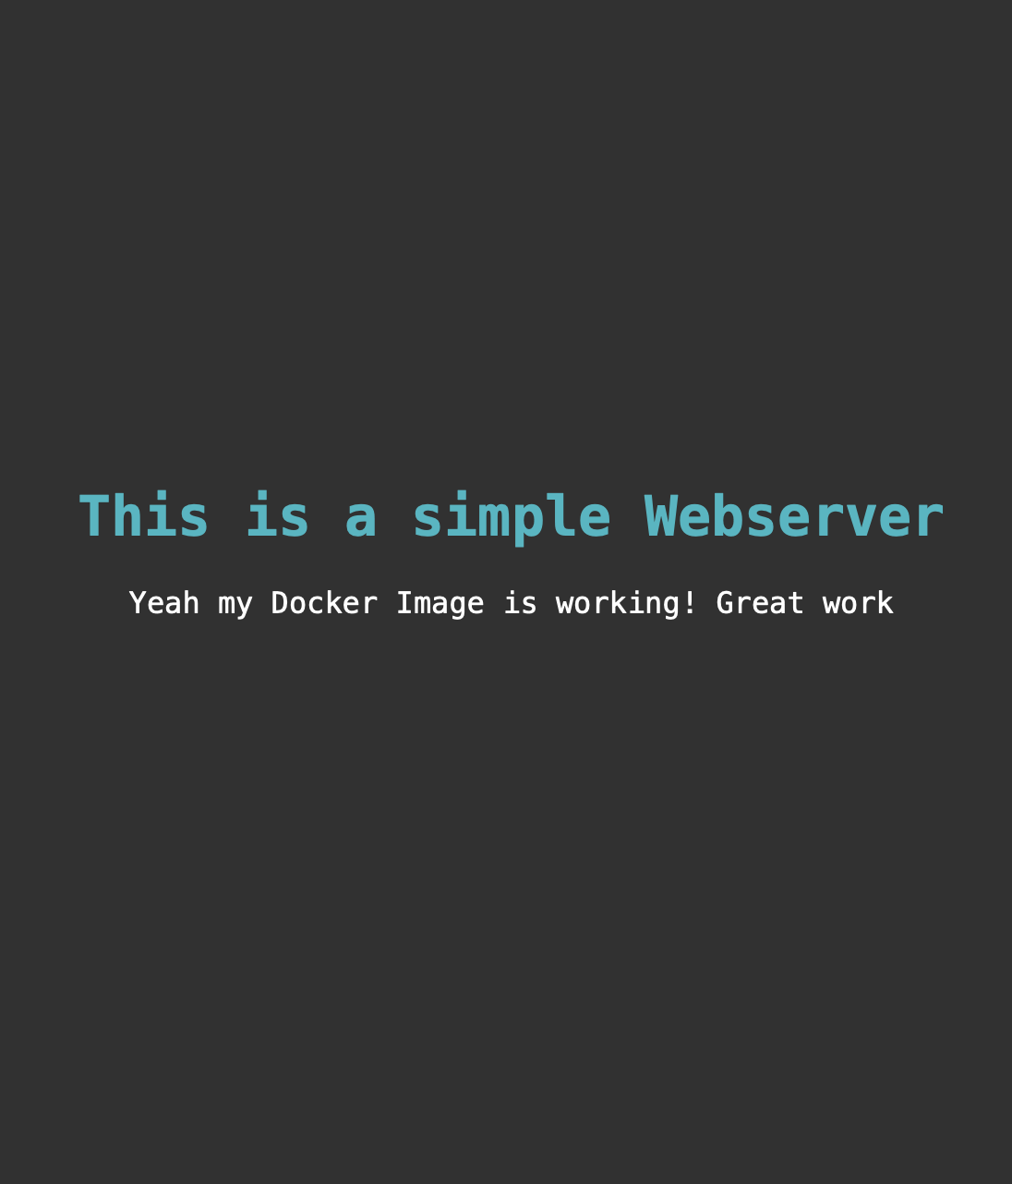
Docker Exercise Explanation of the exercise
Choose the right and a small base image (alpine, centos)
Install an apache http server
Create an index.html file and paste it to the web folder of the apache server
Build and run the container in the detached mode (background)
Start and stop the images «helloworld» and «webserver» with a single docker-compose file

Slide 33
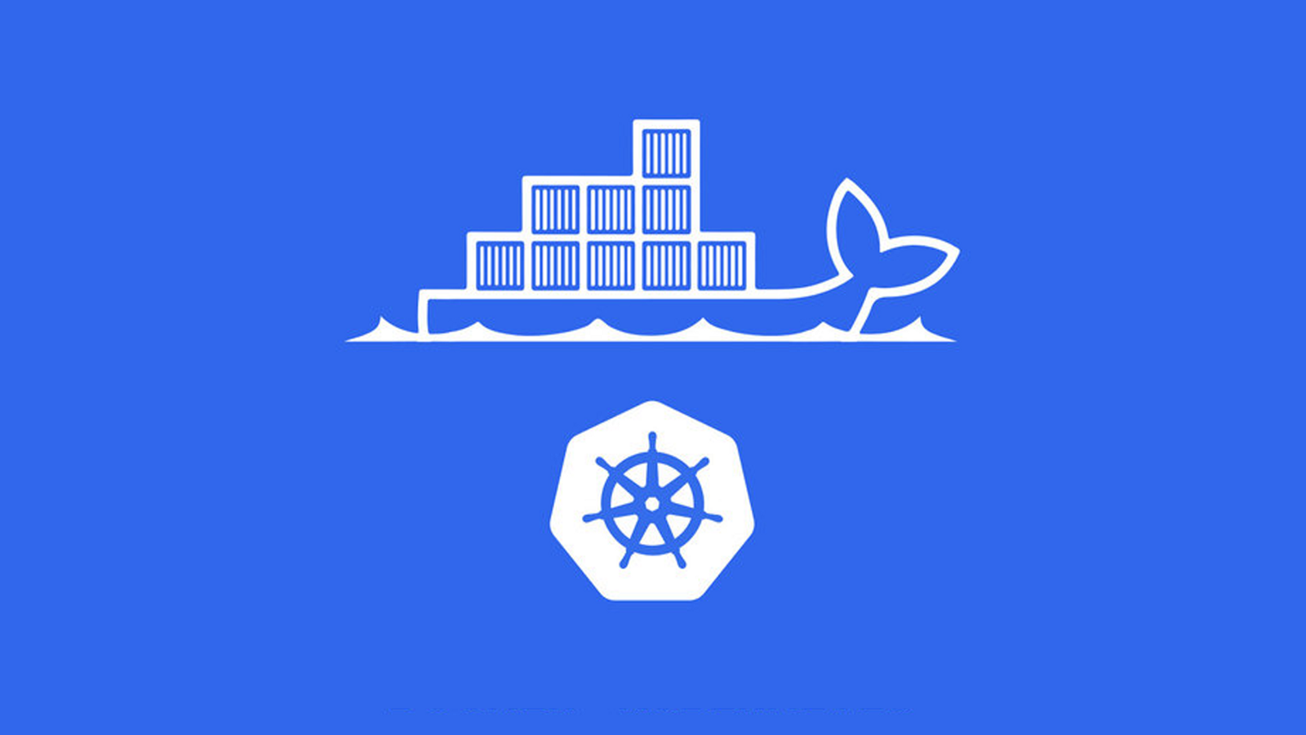

Kubernetes @

Slide 34
Aufzählung in einer Textspalte Gliederung von Themen und Texten
Key figures
Running Container: 3’400
Used Container Nodes: 220
Application purpose
PostAuto Backend
Chatbot and Livechat
Postshop Backend
Automation and Logging Tools

Slide 35
Kubernetes Containerisation with K8S

Slide 36
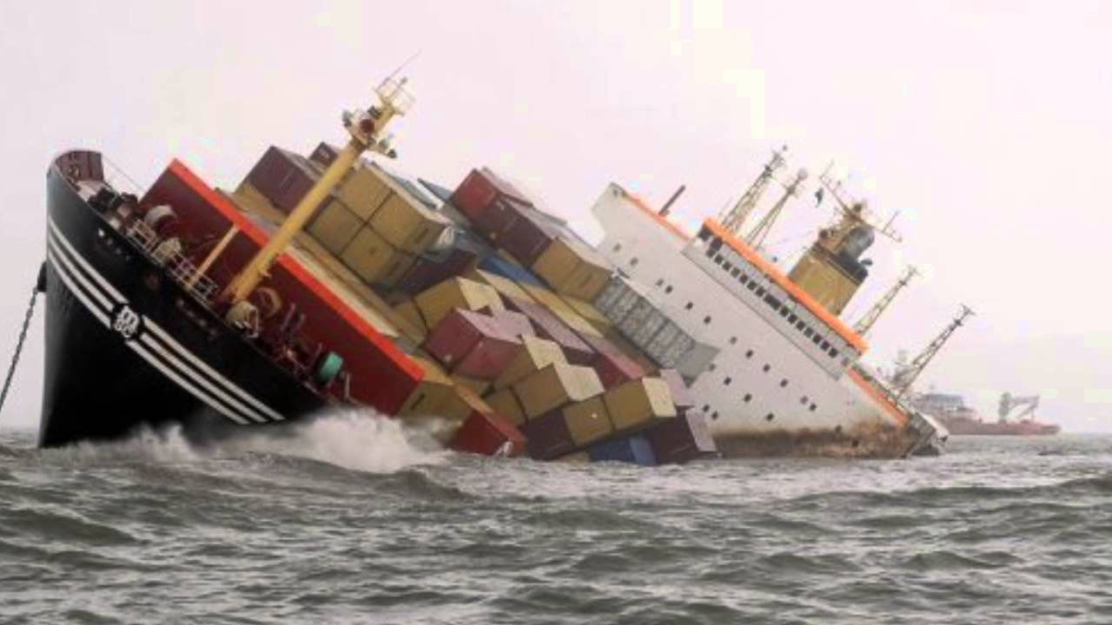
Kubernetes What docker looks like in producation

Slide 37
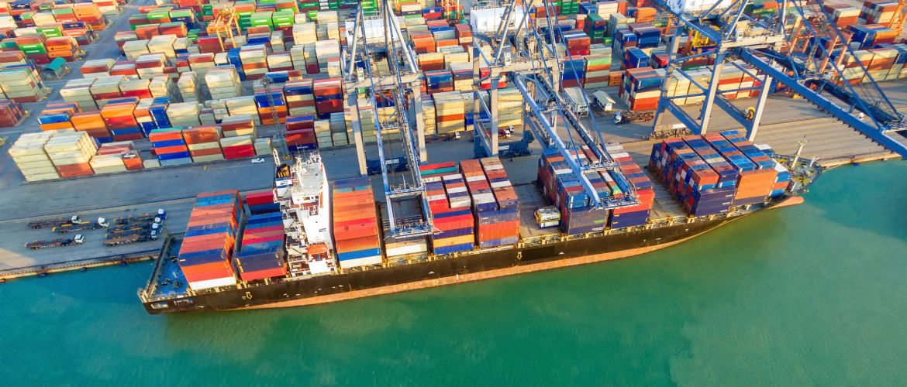
Kubernetes What Kubernetes looks like in producation

Slide 38


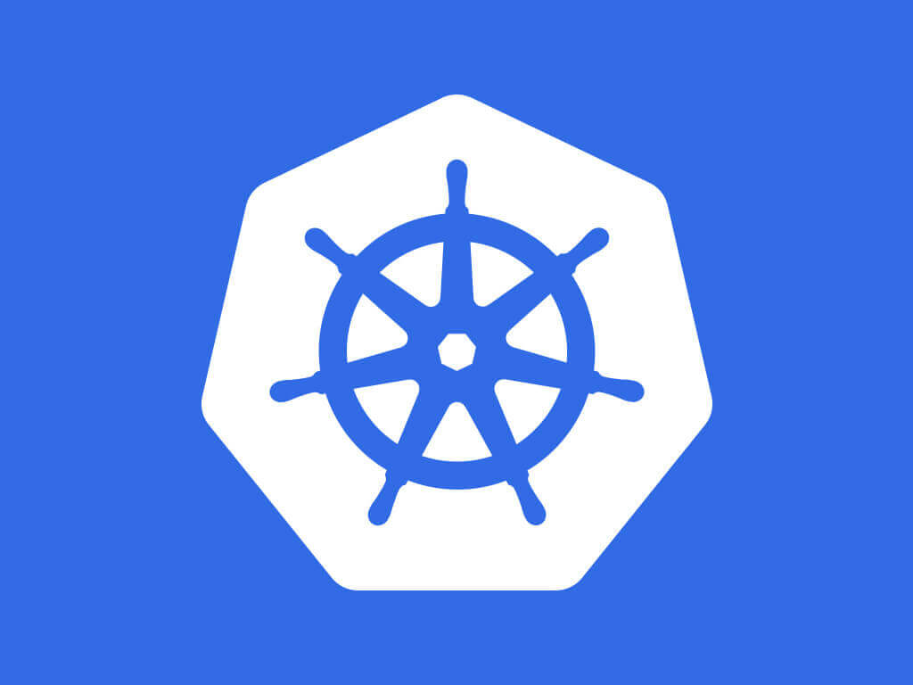





Kubernetes What is Kubernetes?
User Experience
kubectl
Orchestration
Container Engine
Container Host

Slide 39
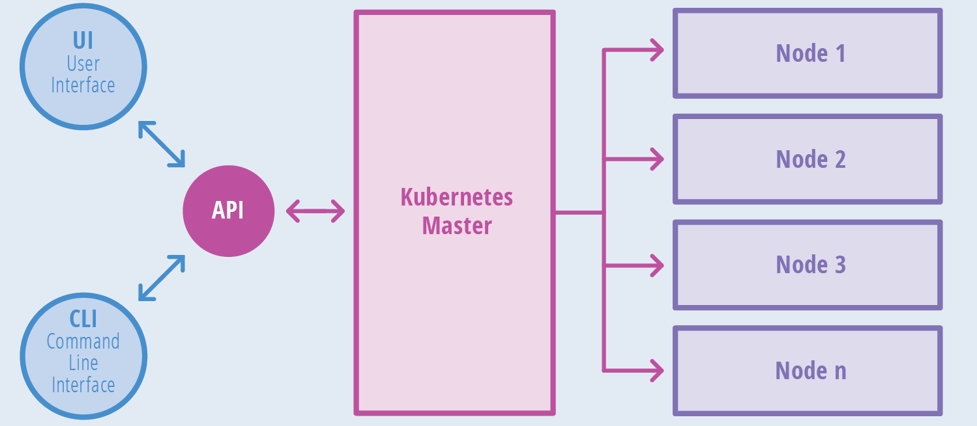
Kubernetes What is Kubernetes

Slide 40


Kubernetes Live Demo
Live Demo

Slide 41

Questions? mweng@post.ch

